Slide 1
New ultra cold dwarf binaries
University of Hertfordshire
Joana Gomes
New discoveries and follow up observations

Slide 2
Outline
New binaries
T dwarf search and summer student
Follow up observations
White dwarf observations

Slide 3
L dwarfs
Cross match of L dwarf candidates and main sequence stars.
Known L dwarfs (DwarfArchive) – 3 pairs
Possible new L dwarfs – 22 pairs
1 – Not a common proper motion binary
2 – Common proper motion
3 – Common proper motion but already discovered by Faherty et al. (2010)
L dwarf binaries
Notes:
As you may remember, I mainly work with main sequence stars in binaries with ultra cold dwarfs. Now, as for my previous work I had done a cross match between a list of MS stars and L dwarf candidates from 2MASS. The most interesting results are as follows. We found 3 possible binaries with known L dwarfs ( from DwarfArchive) and 22 other pairs with L dwarf candidates. Form the known L dwarfs we found one that has common proper motion. (the values for the proper motion are in literature).
L colors = 0.5 < J-H < 1.6
0.4 < H-K < 1.1
1.075 < J-K < 2.8

Slide 4
Binary with the known L dwarf
L dwarf
Main sequence star
L4 dwarf discovered by Cruz et al. (2003).
Low signal-to-noise – L2 or a L6.
Distance = 26.8 ± 5.5 pc
Proper motion - Jameson et al. (2008).
Star in a double system:
K5 star GJ 499A
Variable star – NSV 6094
Distance = 17.15 ± 3.43 pc
L dwarf binaries
Notes:
Now, as for this binary. This is constituted by a known L dwarf, with proper motion measurements already in the archive. It is classified as a L4 dwarf, even though its spectral type might be L2 or L6 due to the low singal-to-noise detection. The spectral classification was done by comparing its spectrum with nine standard L0-L8 spectra. The distance was determined using 2MASS J photometry and the MJ value. The primary star is in fact a double binary with a variable star and a K5 star. The distances are a bit different, but if we take into account the error bars it is possible that these are in fact a bound system! The detection sigma of this discovery is 1.3 which is quite good. The Faherty binary in our sample had a similar value for the sigma detection threshold.

Slide 5
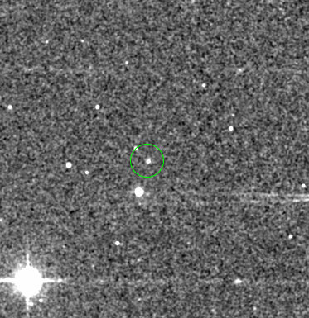
The unknown L dwarfs
From the 22 pairs we found the proper motions using images from:
- 2MASS
- SuperCOSMOS
- DENIS
- UKIDSS
SDSS
For the proper motion errors we took into account:
the error associated with the position of the object in the first epoch (given by the RMS in the IRAF task that was used)
the centroiding accuracy for the second epoch.
8 common proper motion binaries
L dwarf binaries
Notes:
We used two epochs to calculate the proper motion of the L dwarfs. First we used geomap and geoxytran in iraf to see the new coordinates that the object should have in the second epoch. Then we compared that theoretical value with the real one to calculate how much the object had moved in the sky. After having the proper motion for the 22 L dwarf candidates we checked for common proper motion with the main sequence stars (all of them had proper motion measurements in SIMBAD).

Slide 6
Table with information about the new L dwarf candidates + PH star binaries
Special cases
2 - Binary ultra-cool dwarfs: dM9.5 and dL0.5
6 - The brown dwarf is a known object - 2MASS J02212859-6831400 Spectral type M8
8 – Spectroscopic binary
L dwarf binaries
Notes:
We found 8 cases in which the binaries had in fact common proper motion. The results can be shown in the table.

Slide 7
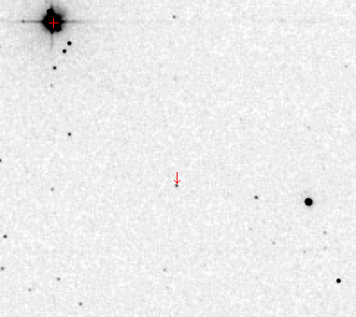
The brown dwarf binary
Discovered by Bouy et al. (2008) and classified as a double binary L9 – M0 by Martin et al. (2006, 2008).
It has common proper motion with a variable star V* V417.
Separation in AU = 5436.78
Sigma detection = 1.08
L dwarf binaries

Slide 8
Summer student research
Uncovering the faintest companions to nearby stars
All sky 2MASS query using the color cuts:
Inferior limit | Color | Superior limit
0.3 | J - H | 1.0
0.0 | H - Ks | 0.8
0.0 | J - Ks | 1.6
The raw sample had more than 1 million candidates!
T dwarf search

Slide 9
Divided the sample in smaller groups
Excluded the more crowded regions (close to the galactic plane)
Cross match with SuperCOSMOS
Cross match with SDSS and apply color cut I – J > 4
Visual inspection
Check with SIMBAD
Check with DwarfArchive
Exclude solar system bodies
238 possible ultra cold dwarfs
4 possible binaries!
T dwarf search

Slide 10
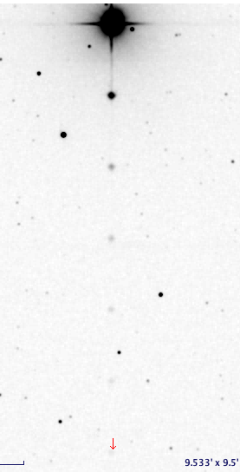
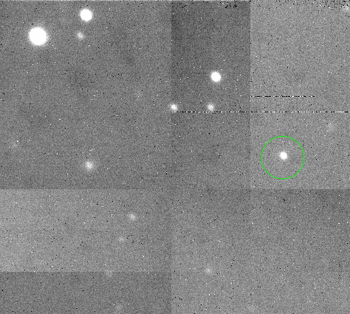
Observations
We observed two T dwarf candidates
One object didn’t show up in the second epoch
The other one is a spurious source from 2MASS but there is something bright in the observations!
2MASS image in the J band
Observations
SOAR image

Slide 11
White dwarfs
Using the IMACS spectrograph we observed 42 targets – white dwarf candidates in WD-MS star binaries.
29 confirmed white dwarfs
Reduction of the WD spectra
Metallicity of the MS star
1- Study the link between WDs with strong metal lines and the existence of planet remnants – precise metallicities and atomic abundances for the MS counterpart.
2 – Determine precise ages (better than 10%) for the MS counterparts using the WD cooling age
Observations

Slide 12
Future
Follow up observations for the T dwarf candidates
Check the new 4 T dwarf- MS star binaries for common proper motion
Reduction of the white dwarfs spectra
Metallicities for the MS star counterparts
Paper with the new WD-MS star binaries sample
Paper about the new binaries
Future

