Slide 1
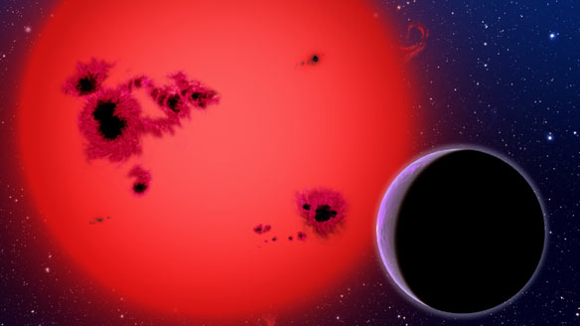


M Dwarf Variability & Transits In The Near Infrared
RoPACS Meeting Lisbon 2010
Niall Goudling (n.t.goulding@herts.ac.uk)

Slide 2
Overview
Introduction
Selecting candidate M dwarfs
Identifying variable stars
Light curve manipulation
Some results

Slide 3
Introduction
Variability of M dwarfs has a wide impact:
  Understanding magnetic activity and variability of M dwarfs
  Implications of transit surveys
  Implications for astrobiology
Up to 80% of later M dwarfs are active.
Spot coverage can be over 50% and up to ~70%.
S. Sciortino et al. (1998)
A. Reiners (2006)

Slide 4
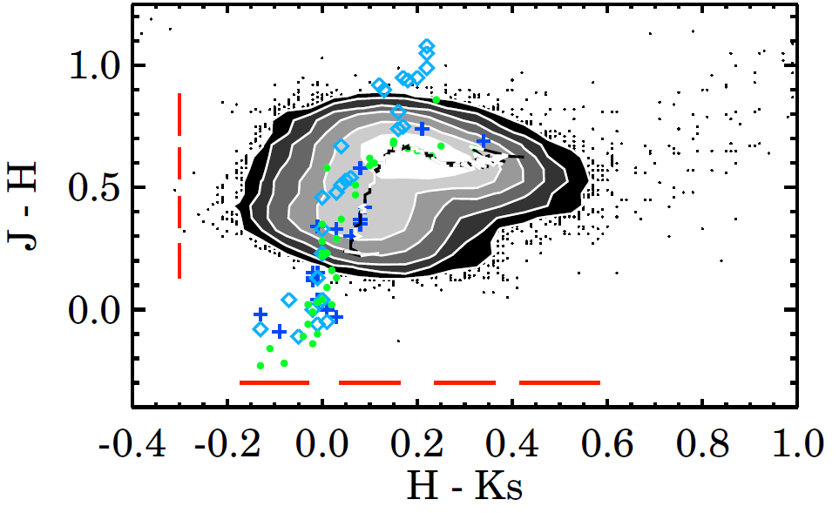
Selecting M Dwarfs
Using relations from Covey et al (2007)
Luminosity class tracks on colour colour plots
(Plots used: r-i vs g-r; z-J vs i-z; J-H vs z-J; H-Ks vs J-H; i-Ks vs g-i)

Slide 5
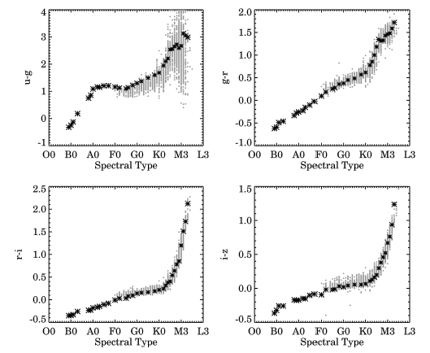
Selecting M Dwarfs
Using relations from Covey at al (2007)
Luminosity class tracks on colour colour plots
+
Polynomials fitted to standard spectral positions in 7D colour space
(Plots used: r-i vs g-r; z-J vs i-z; J-H vs z-J; H-Ks vs J-H; i-Ks vs g-i)

Slide 6
Estimating Spectral Type/Lum. Class
Using 2MASS (JHK_{s}) and SDSS (ugriz) filters
Each colour-colour plot estimates a class for a star.
Each colour-type plot estimates a type.
Modal class found.
Resistant mean of spectral types found to give “average” spectral type.
Sample of ~3800 potential M dwarfs in total.

Slide 7
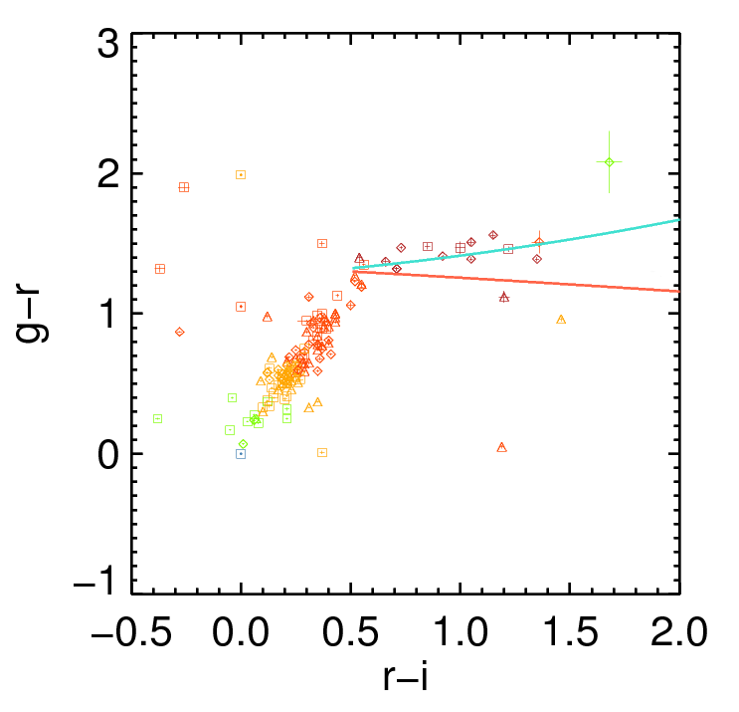


Slide 8
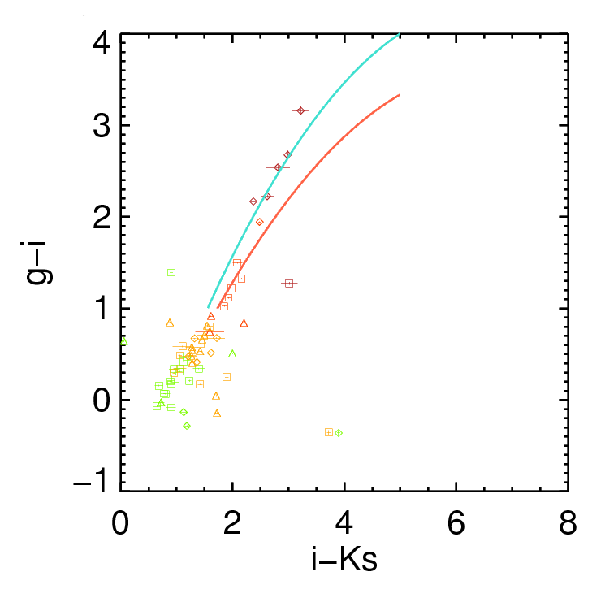

Slide 9
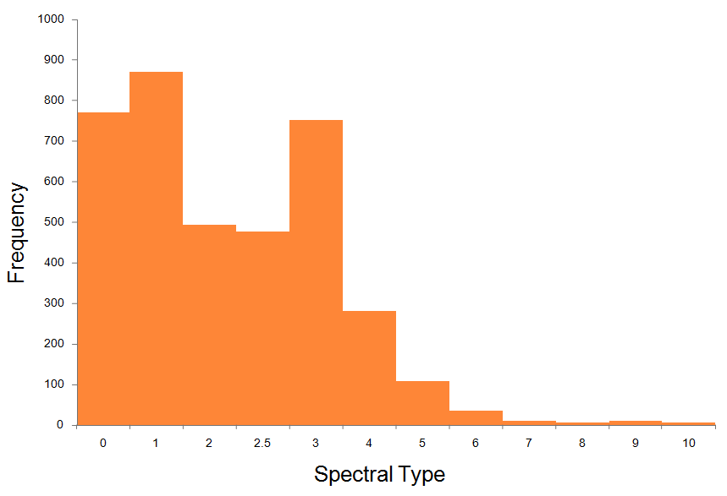
19hr Field Spectral Types
Frequency
Spectral Type

Slide 10
Periodograms
M Dwarf candidate → Periodogram + folding code
Periods found in light curves with Lomb-Scargle Periodogram.
Least squares sinusoid fitting.
Generally good with intrinsic variations and deep EBs.
Not good with transits or shallow EBs.

Slide 11
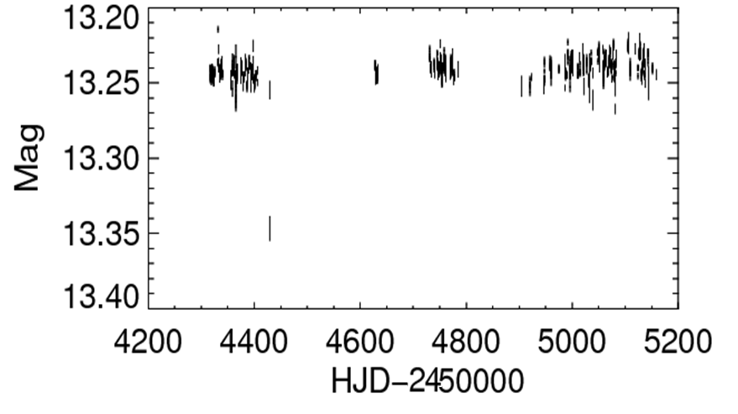
19.55+36.60-3_3751

Slide 12
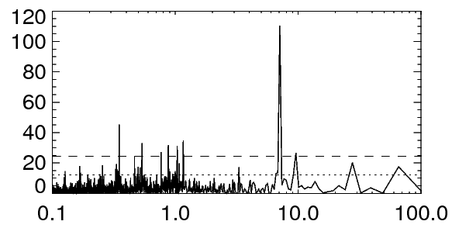
Periodogram
Peak at 7.08 days
Power
Period (days)

Slide 13
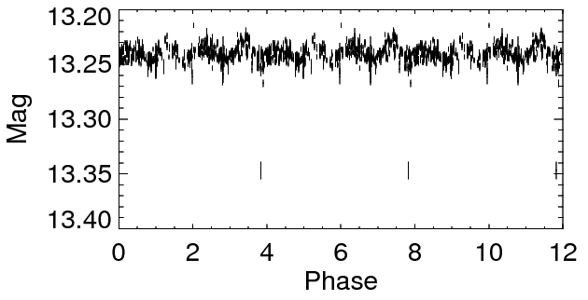

Slide 14
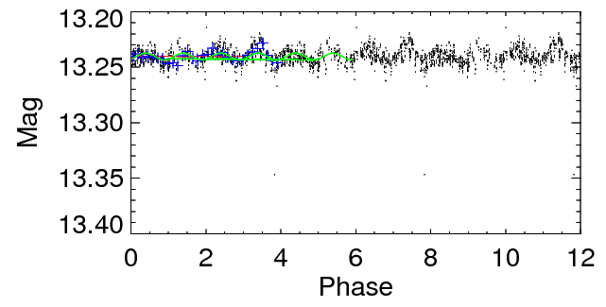

Slide 15
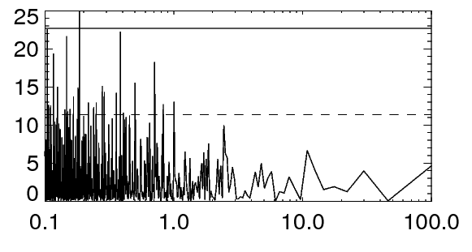
Periodograms have only limited use:
19.55+36.60-2_1819
Peak corresponding to EB period p=0.83 days
Power
Period (days)

Slide 16
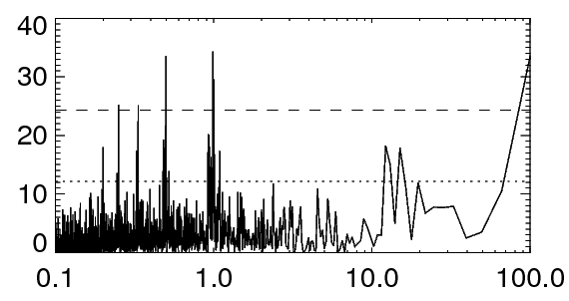
Problems...
Aliasing with observational period...

Slide 17
Problems...
Aliasing with observational period...
Periods at 1.000, 0.500, 0.333, 0.250, 0.200 (±0.0005) days

Slide 18
Problems...
Aliasing with observational period...
Periods at 1.000, 0.500, 0.333, 0.250, 0.200 (±0.0005) days
Follow up?

Slide 19
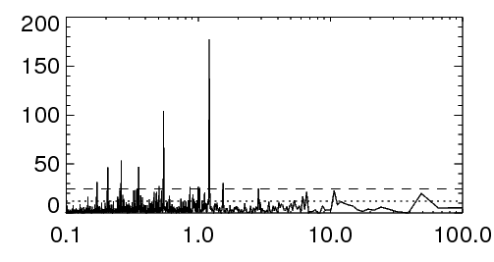
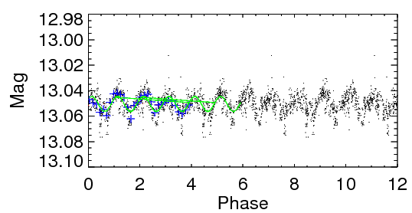
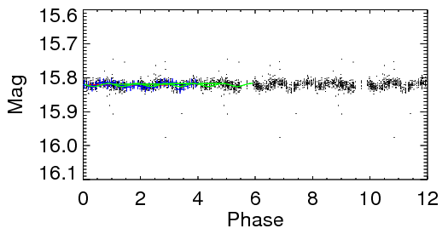
Some Examples
Spectral Type=M2.5±1.21
Period= 3.82 days

Slide 20
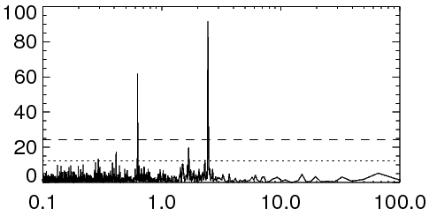
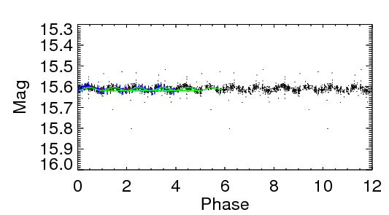
Some Examples
Spectral Type=M2±0.61
Period= 2.45 days

Slide 21
Some Examples
Spectral Type=M2±0.61
Period= 2.45 days
Second period?

Slide 22
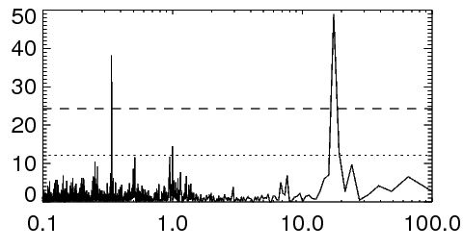
Some Examples
Spectral Type=M1±1.18
Period= 17.48 days

Slide 23
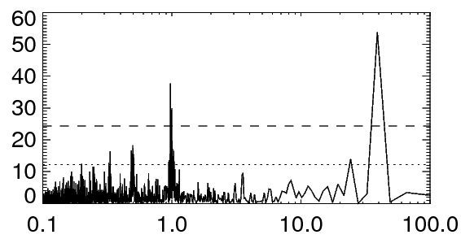
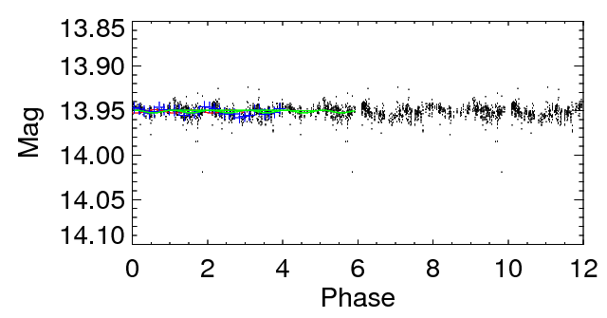
Some Examples
Spectral Type=M0±2.07
Period= 35.58 days

Slide 24
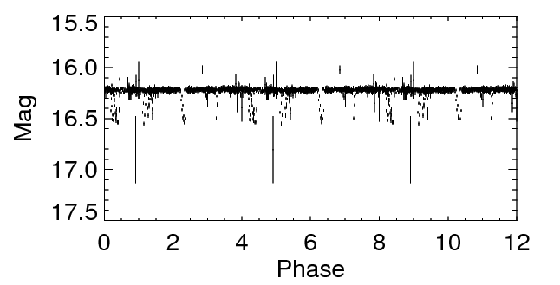
A Few EBs...

Slide 25
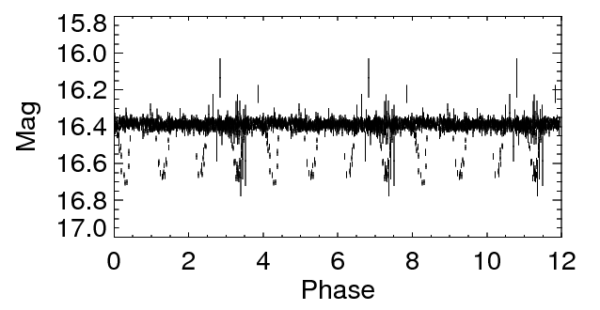
A Few EBs...

Slide 26
A Few EBs...
But only 33 variable stars so far....

Slide 27
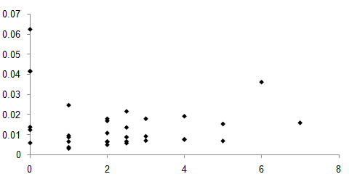
Some Results...
Amplitude
Spectral Type

Slide 28
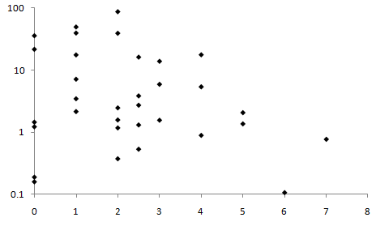
Some Results...
Period
Spectral Type

Slide 29
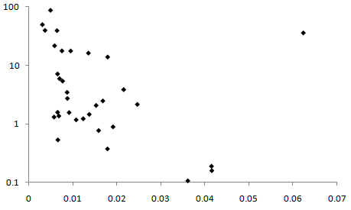
Some Results...
Period
Amplitude

Slide 30
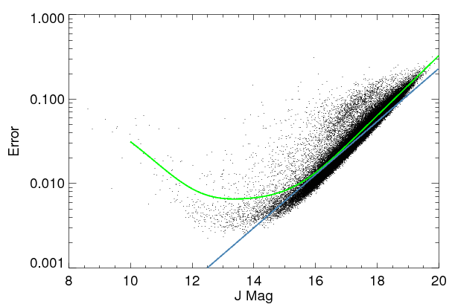
Impact of Nearby Stars?
83%
90%
57%

Slide 31
Future work
Improve stellar classification.
More thorough period search; follow up for longer periods.
Gain an idea of the fraction of M dwarfs that are periodically variable.
Period search in 03hr, 07hr and 17hr fields.
Can flaring events be detected in WTS light curves?

Slide 32
Summary
Understanding activity of M dwarfs is important for better transit models and transit identification.
M dwarf variability seems to be low level (~ ±0.01 Mag)
More periodicity needs to be found to identify p, A, and Spectral Type relations (if any).

Slide 33
Thank you!

